Slide 1
Tech Industry's Workforce Diversity
Members: mary gong, Kristen Cannon, Kelly Blumhagen

Slide 2
Women in the US Tech Industry
Diversity: something the tech world has been talking about for decades. There are panels at conferences, books, podcasts and so much more dedicated to the topic
And yet, the numbers are still quite discouraging
Google for example (2014 – 2018):
70% Male vs 30% Female
Google source: https://www.statista.com/statistics/311800/google-employee-gender-global/

Slide 3
Initial Ideas
Bar Chart (Job Position)
Job Position in top tech companies
Interactive Filter by Gender
Bar Chart (Salary)
Difference in Median Salary between early career and mid career
% of women and men in the company
Pie Chart
% of men vs women in top tech companies
User interactive filters:
Company name
Gender
Map
Color States based on earnings between Women vs Men – Wage gap

Slide 4
Initial Ideas - Visualization

Slide 5
Data source used
Diversity IN top tech companies, broken down into Job position, gender, company name
Gender wage ratio
Data World: Employee Diversity in Tech 2014 – 2018

Slide 6
Challenges
Finding the appropriate data sources – original idea was to compare Salary between gender but was not able to find any good resources
We initially wanted to incorporate both bar graph and pie chart for one of the data sets, and depending on filter selected, both bar graph and pie chart would be updated – lack of data prevented us from doing this
Embedding Tableau charts into HTML

Slide 7
Technologies used
Pandas: clean up data sources
MySQL: using pandas to sync into MySQL to create our desired table
Tableau: Bar graph and Pie chart visualization
HTML/CSS: beautify the webpage
Geo-mapping: display data on the US map

Slide 8
Team work
Kristen & Kelly: finding data sources, using Tableau & HTML/CSS for visualization
Kristen & Mary: Cleaning data sets to be used for visualization
Mary: Geo-Mapping visualization, setting up Python Flask and MySQL database
Group: Presentation

Slide 9
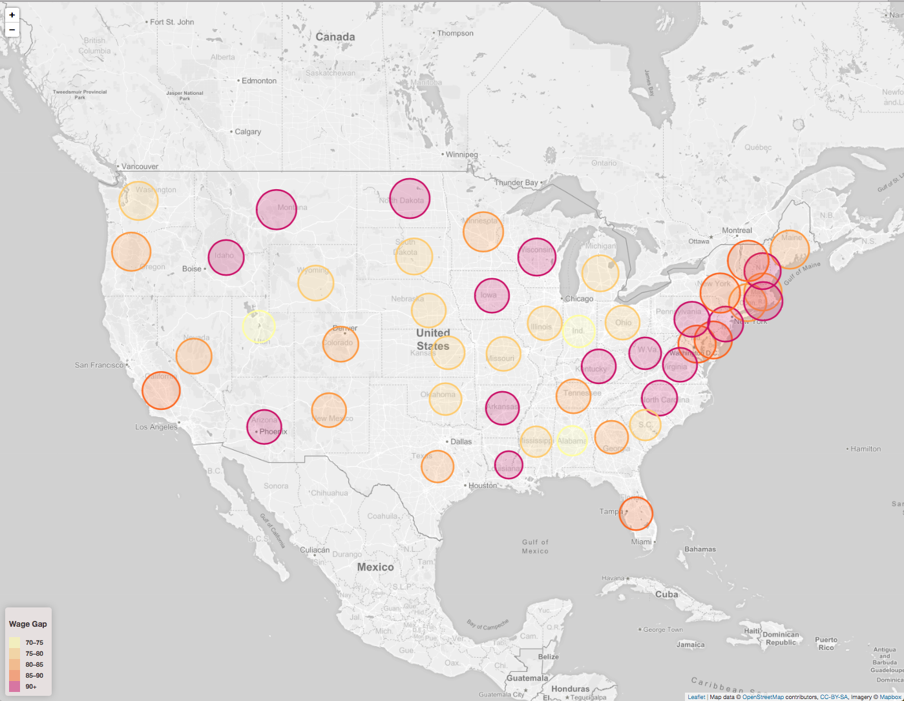
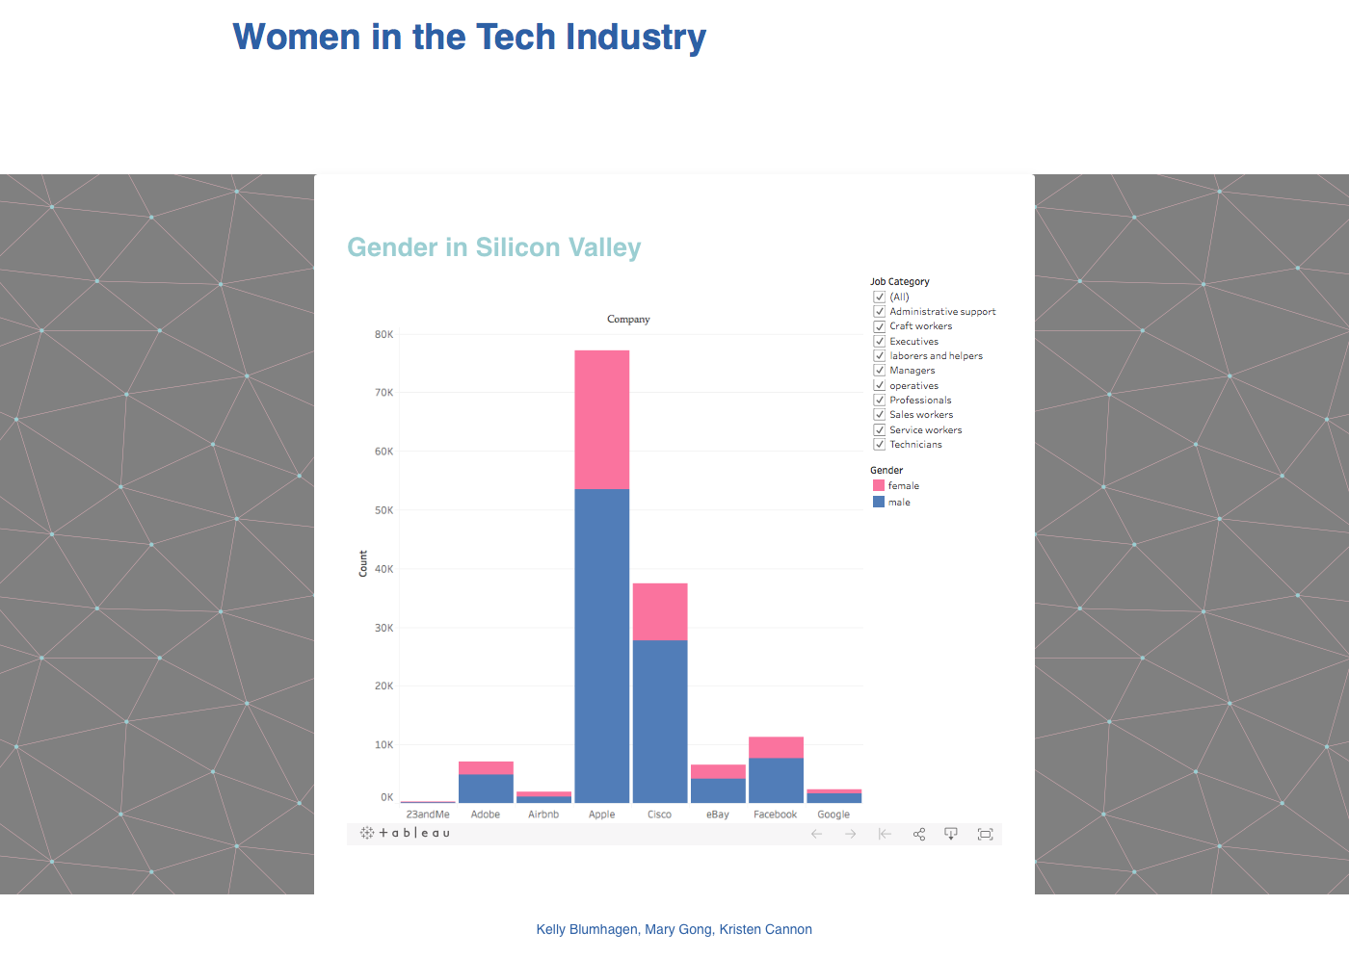
Snap Shots

Slide 10
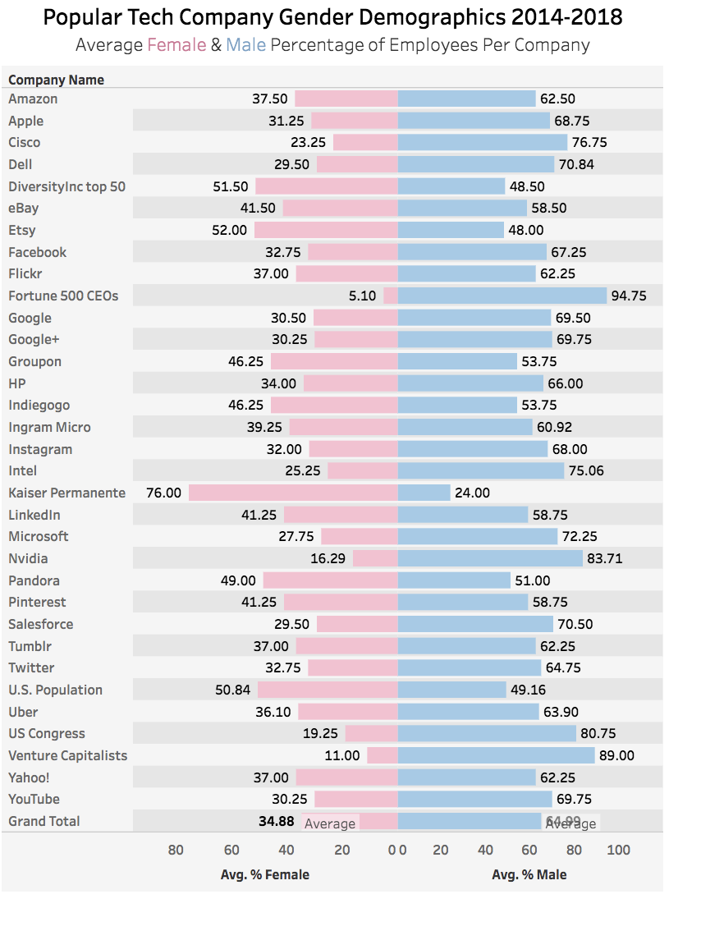
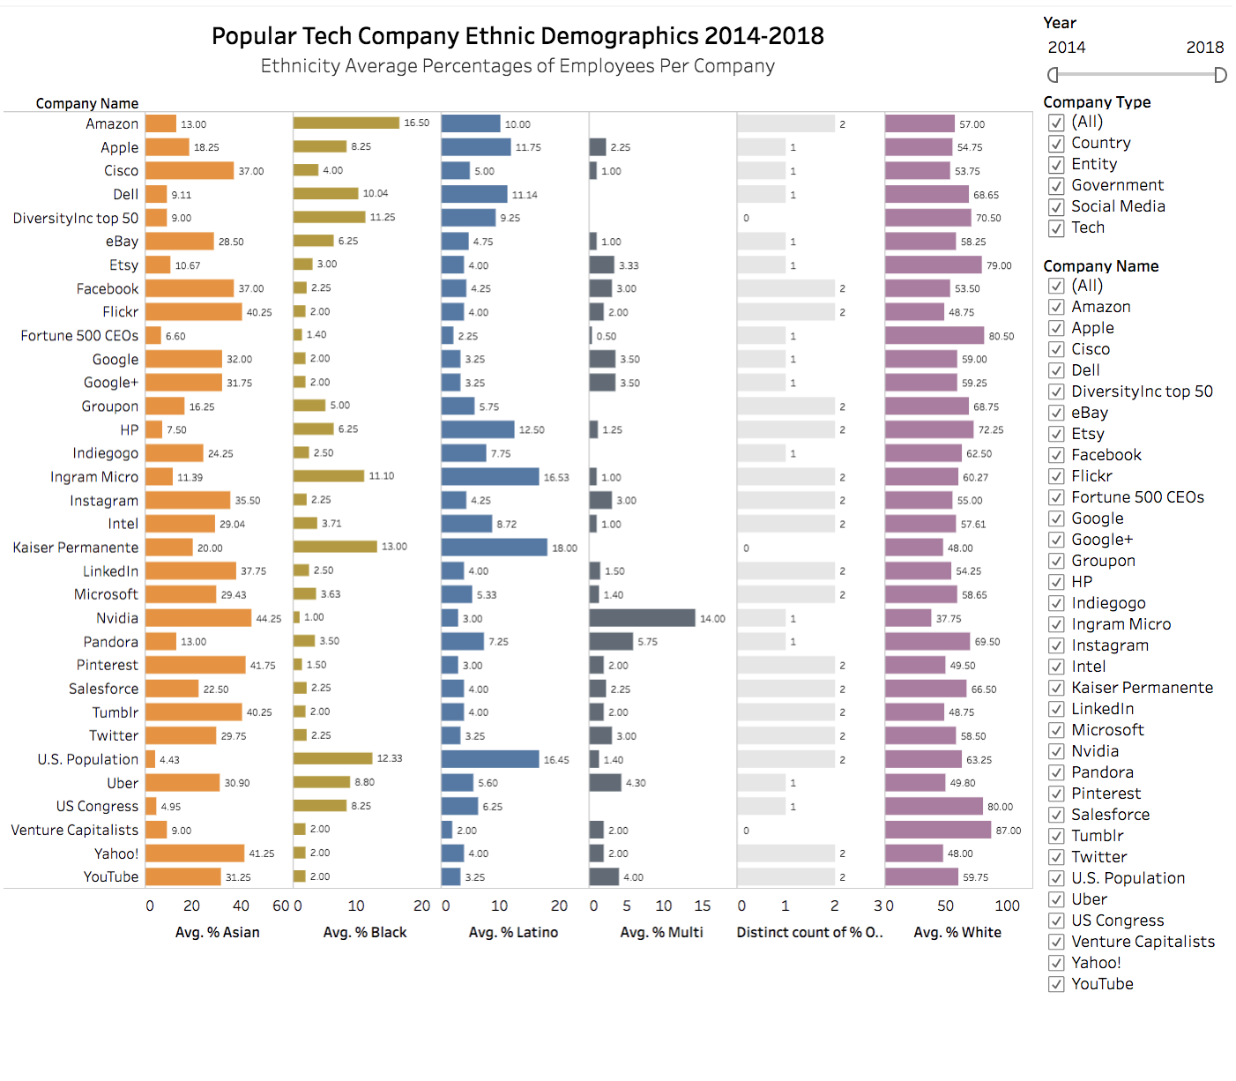
Snap Shots

Slide 11
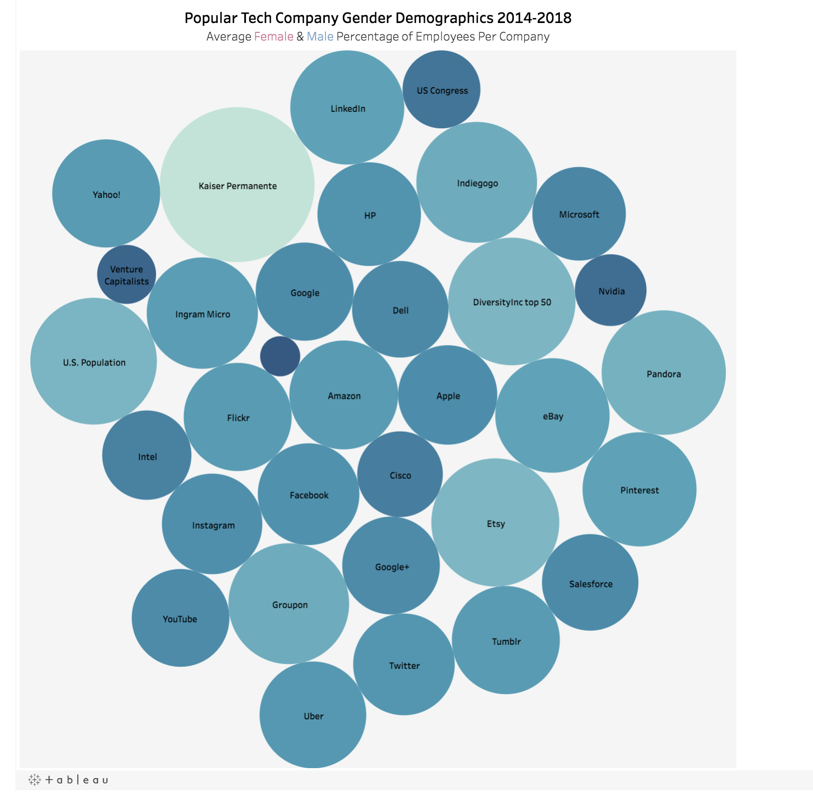
Snap Shots

Slide 12
Demo

